Slide 1
Weights and Scoring of Evidence in the Open Targets Platform
Open Targets Core Team
July 02, 2018
https://www.targetvalidation.org

Slide 2



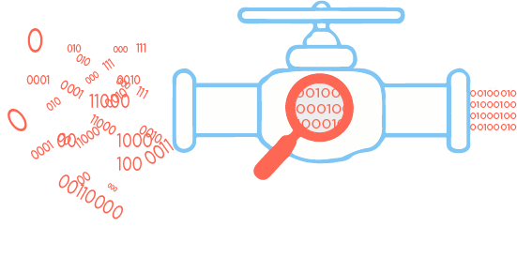



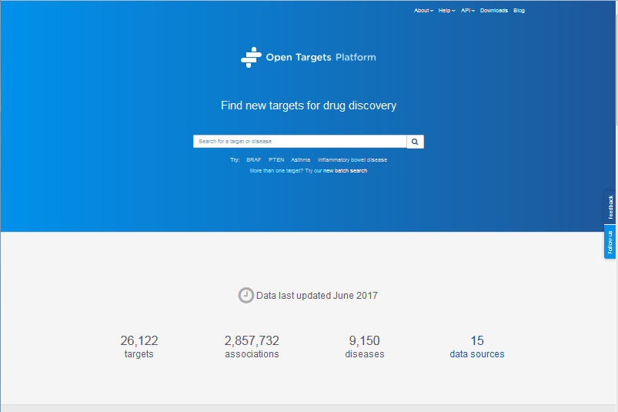


Target ID and Prioritisation Knowledge Cycle
Public Data
Experimental Projects
Bioinformatics Projects
Data Generation
Data Integration
targetvalidation.org
Therapeutic Hypothesis

Slide 3
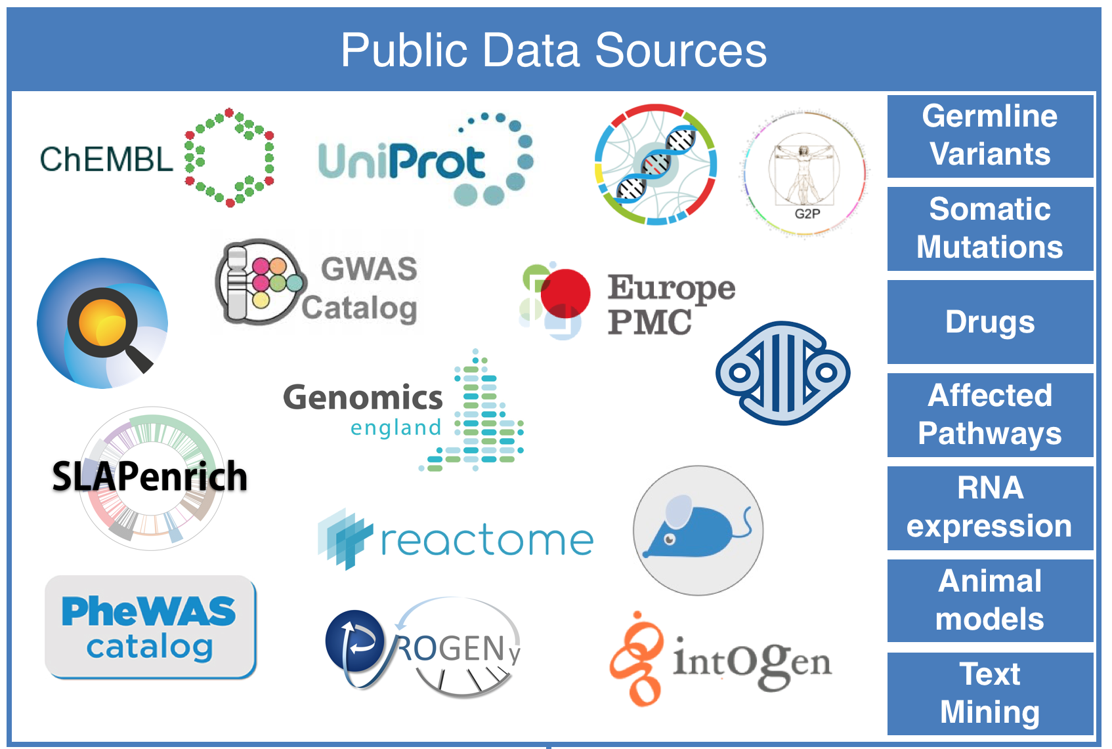
Evidence for Target-Disease Associations
Evidence
Target
Ensembl Gene ID
Disease
EFO

Slide 4

Data Sources for Evidence Data Types
Germline Variants | Somatic Mutations | Drugs | Affected Pathways | Differential RNA expression | Animal Models | Text Mining
Europe PMC
Expression Atlas
PhenoDigm
EVA
EVA
Cancer Gene Census
GWAS
Catalog
PheWAS

Slide 5

Factors affecting the relative strength of an evidence
e.g. GWAS Catalog
S = f * s * c
f, relative occurrence of a target-disease evidence
s, strength of the effect described by the evidence
c, confidence of the observation for the target-disease evidence
f = sample size (cases versus controls)
s = predicted functional consequence
c = p value reported in the paper

Slide 6
Generalised scoring approach
Data source score = f * S * C
e.g. GWAS Catalog:
f = normalised sample size >= 5000 = 1
S = functional consequence score of variants
e.g. transcript ablation = 1, intronic = 0.5
C = normalised p-value
-log₁₀ P
Notes:
Is this specific to GWAS?

Slide 7
Data type | Data source | Scoring of data sources
Genetic Association | GWAS & PheWAS EVA (ClinVar) UniProt Gene2Phenotype Genomics England PanelApp | Functional consequence score of variants, normalised p-value and normalised sample size Functional consequence score of variants Curator: strong evidence = 1, otherwise 0.5 Variants are inferred by curators = 1 Score = 1 because gene-disease associations are curated and crowdsourced by experts
Somatic mutations | Cancer Gene Census & EVA UniProt IntOgen | Functional consequence score of variants Binned score based on tumour type categories Positive selections for gene in the tumour: score = 0.25. As above + gene described as a cancer gene: score = 0.5. As above + gene is functionally connected to other genes in the same tumor type: score = 0.75
Drugs | ChEMBL | Clinical trials phase binned score Phase 0: score = 0.09, Phase I: score = 0.1, Phase II: score = 0.2, Phase III: score = 0.7, Phase IV: score = 1
Affected Pathways | Reactome SLAPenrich*0.5 PROGENy | functional consequence of 1 for a pathway inferred by a curator
RNA expression | Expression Atlas*0.5 | normalised p-value, normalised expression fold change and normalised percentile rank
Text mining | Europe PMC*0.2 | Weight for document sections, sentence locations and title for full-text articles and abstracts
Animal models | PhenoDigm*0.2 | similarity score between a mouse model and a human disease​ described by Smedley et al 2013 (Filter PhenoDigm evidence with scores < 0.4)
Notes:
Each data source has its own scoring and ranking system.

Slide 8
How do we score associations?
Score: 0 to 1 (max)
Calculated at 4 levels:
Evidence
Data source
Data type
Overall
Should be 3 levels, harmonic sum is applied 3 times: on 1) evidence, 2) data sources and 3) data type to get the overall score.
Evidence
Data source
Data type
Overall
Σ_{H}
Genomics England
Σ_{H}
PhEWAS catalog
Σ_{H}
EVA
Σ_{H}
Genetic associations
Σ_{H}
UniProt
Σ_{H}
Gene2Phenotype
Σ_{H}
GWAS catalog
Σ_{H}
Cancer Gene Census
Σ_{H}
EVA (somatic)
Somatic mutations
Σ_{H}
IntOGen
Σ_{H}
Σ_{H}
UniProt
Σ_{H}
Association score
Σ_{H}
ChEMBL
Drugs
Σ_{H}
Need to ask CK about pathways scoring, ie:
PROGENy weight is 1
Are all three summarized with a harmonic sum?
Reactome
Σ_{H}
SLAPenrich
*0.5
Σ_{H}
Affected pathways
Σ_{H}
PROGENy
Σ_{H}
Expression Atlas
*0.5
RNA expression
Σ_{H}
Europe PMC
*0.2
Text mining
Σ_{H}
PhenoDigm
*0.2
Animal models
weight factor
Σ_{H}
S₁ + S₂/2² + S₃/3² + S₄/4² + S_{i}/i²
Notes:
The weights are based on the code in Settings.py:
SCORING_WEIGHTS = defaultdict(lambda: 1) SCORING_WEIGHTS['phenodigm'] = 0.2 SCORING_WEIGHTS['expression_atlas'] = 0.5 SCORING_WEIGHTS['europepmc'] = 0.2 SCORING_WEIGHTS['slapenrich'] = 0.5 # SCORING_WEIGHTS['gwas_catalog'] = 1.5 # setup a minimum score value for an evidence string to be accepted. SCORING_MIN_VALUE_FILTER = defaultdict(lambda: 0) SCORING_MIN_VALUE_FILTER['phenodigm'] = 0.4

Slide 9
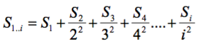
Aggregating Scores
Using a mathematical function, the harmonic sum*
Σ_{H}=
where S₁,S₂,...,S_{i} are the individual sorted evidence scores in descending order
Advantages:
Account for replication
Deflate the effect of large amounts of data e.g. text mining
* PMID: 19107201, PMID: 20118918

